Slide 1
2104 Team A3 Motor
Members:
Noor Fathima D/O Salahudeen
Jodie Au
Siti Sarah Binte Mohamad Jailani
2102557
2102418
2102471
Notes:
We are the motor team and our team members are Sarah, Jodie and me Fathima

Slide 2
Initialisation
Notes:
Initialisation

Slide 3
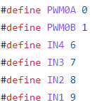
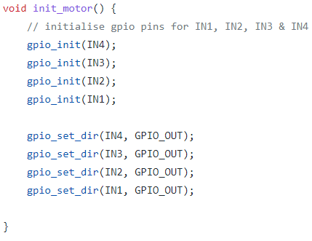
Pins
Pins used for Motor
Notes:
This is the pins we used for our motors

Slide 4
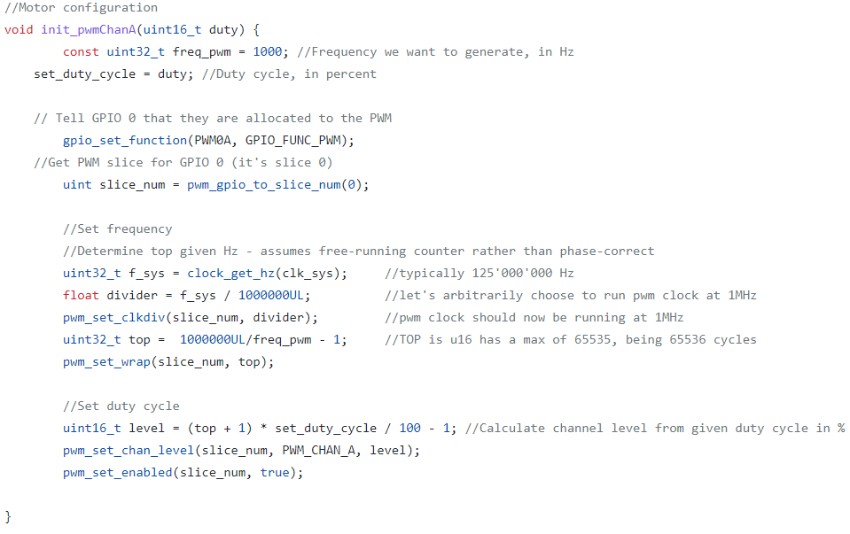
PWM
Setting up the PWM for right motor
Notes:
This is the PWM for the right motor

Slide 5
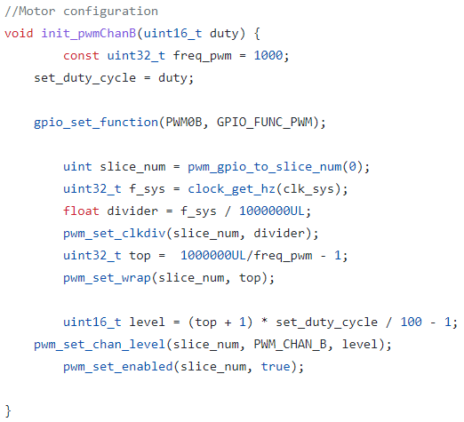
PWM
Setting up the PWM for left motor
Notes:
And this is the PWM for the left motor

Slide 6
Movement
Notes:
Now I wll talk about the movement

Slide 7
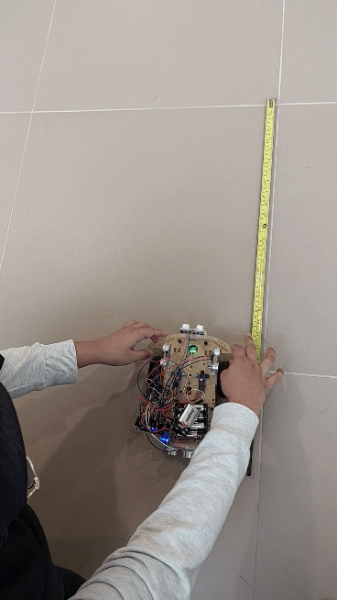
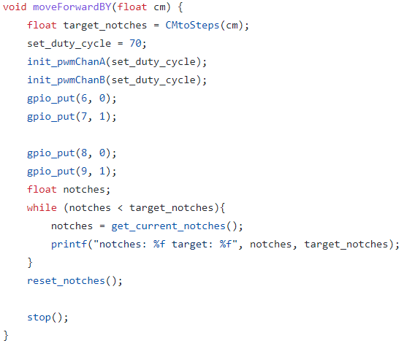
Move Forward
Car moves forward by Distance (cm)
Notes:
This is how the car moves forward by specific cm by using notches to detect the distance travelled

Slide 8
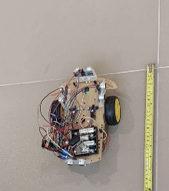
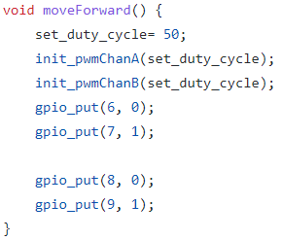
Move Forward
Continuous
Notes:
This is how the car moves forward continuously

Slide 9
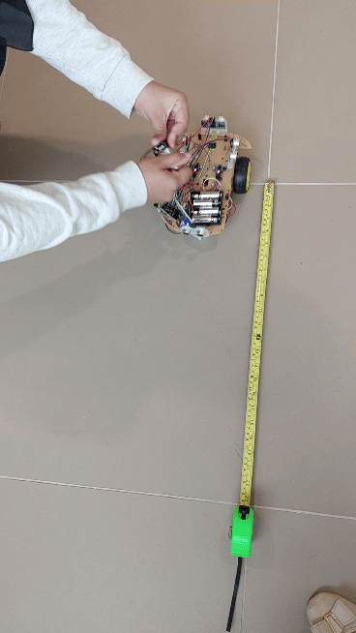
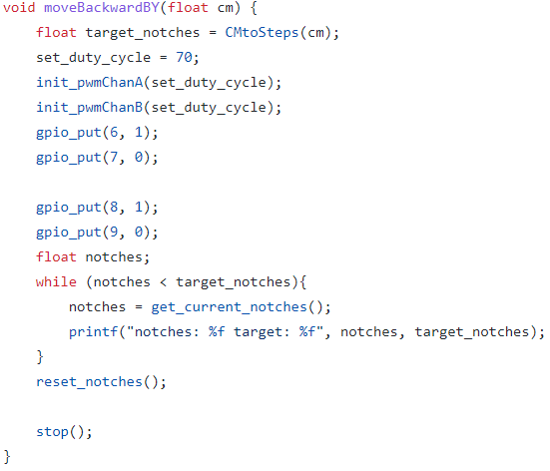
Move Backward
Car moves backward by distance (cm)
Notes:
This is how the car moves backward by specific cm using notches to detect the distance travelled

Slide 10
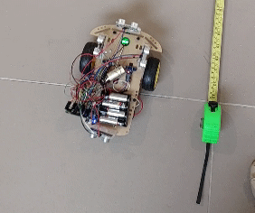
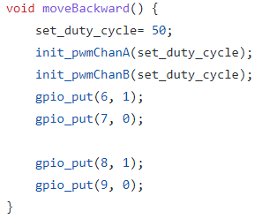
Move Backward
Continuous
Notes:
This is how the car moves backward continuously

Slide 11
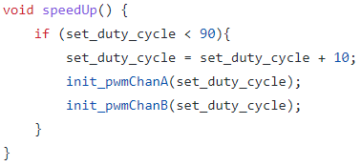
Speed Up
Increase speed (duty cycle) by 10%
Notes:
This is how the car speeds up by 10% and the maximum duty cycle is 90%

Slide 12
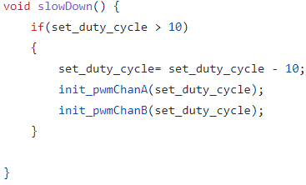
Slow down
Decrease speed (duty cycle) by 10%
Notes:
This is how the car slows down by 10% and the minimum duty cycle is 10%

Slide 13
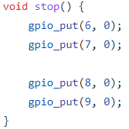
Stop
Stops all car movement
Notes:
This is how the car stops

Slide 14
Turning Accuracy
Notes:
Now I will talk about the turning accuracy

Slide 15
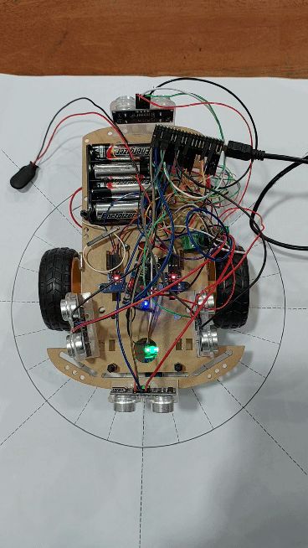
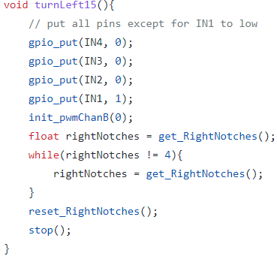
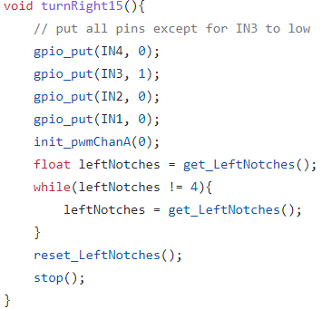
15 degrees
Notes:
This is how the car turns at 15 degrees

Slide 16
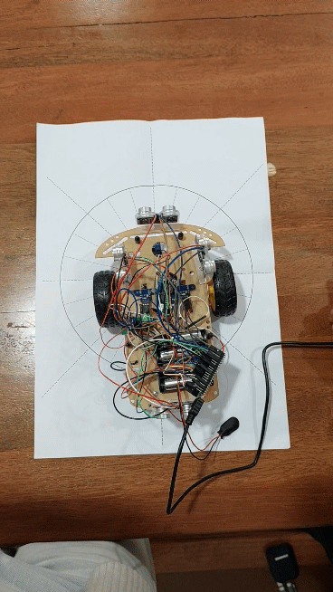
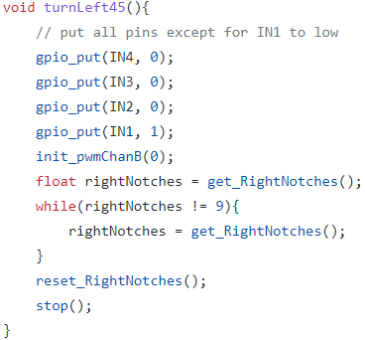

45 degrees
Notes:
This is how the car turns at 45 degrees

Slide 17
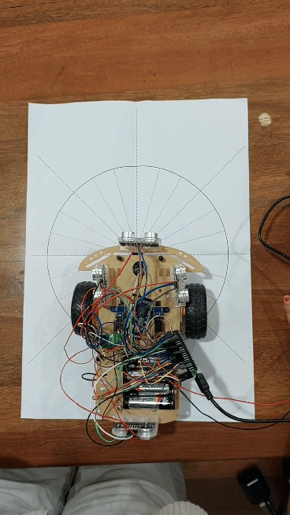
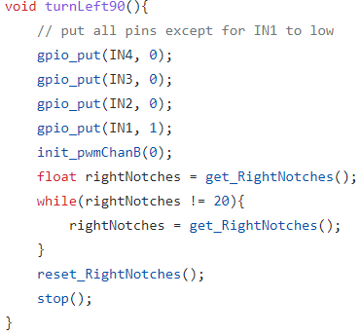
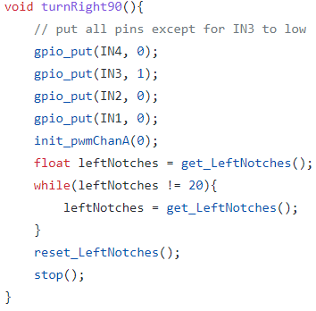
90 degrees
Notes:
This is how the car turns at 90 degrees

Slide 18
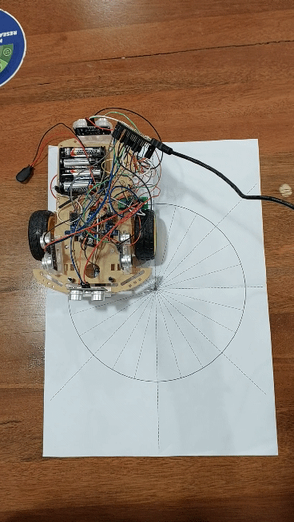

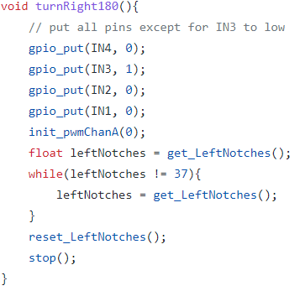
180 degrees
Notes:
This is how the car turns at 180 degrees

Slide 19
PID
Notes:
Now we will talk about the pid calculation

Slide 20
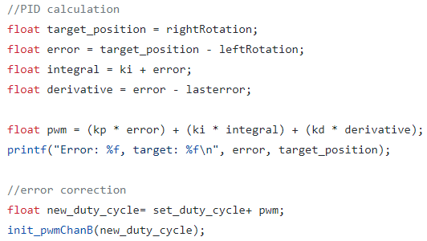
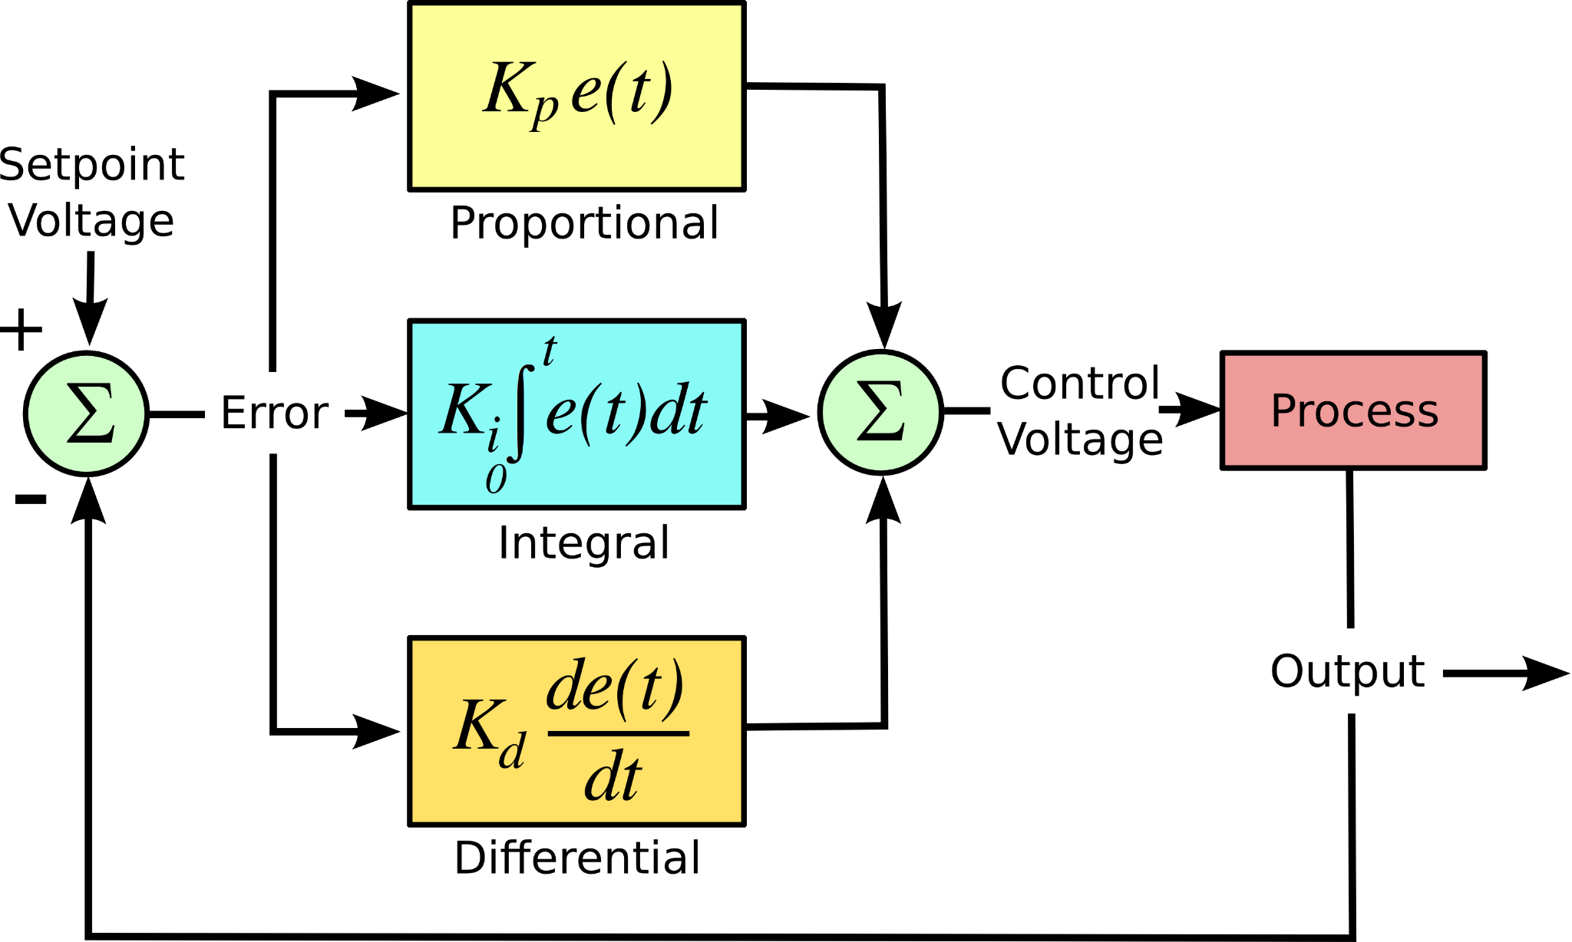
PID
Notes:
This is the formula we used for our PID calculation

Slide 21
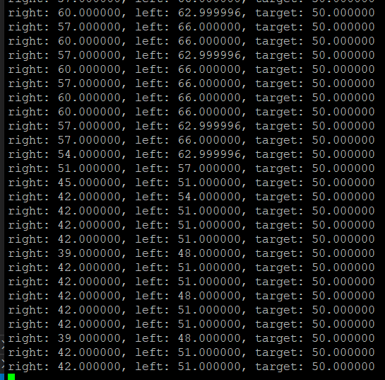
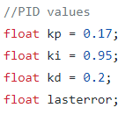
PID - Tuning Method:
Ziegler Nichols
Step 1: Find P value by determining the oscillation point
Right motor: 39 - 60 rpm
Left motor: 48 - 66 rpm
Notes:
We used the Ziegler Nichols method to tune our pid
Step 1: Find P value by determining the oscillation point

Slide 22
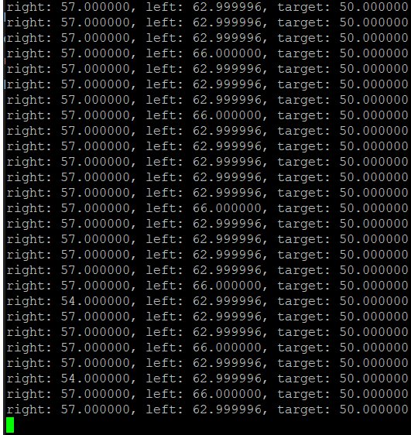
PID - Tuning Method:
Ziegler Nichols
Step 2: Find I value by determining the fastest time taken to correct
Right motor: 54 - 57 rpm
Left motor: 62 - 66 rpm
Corrects in 1 cycle
Notes:
Step 2: Find I value by determining the fastest time taken to correct

Slide 23
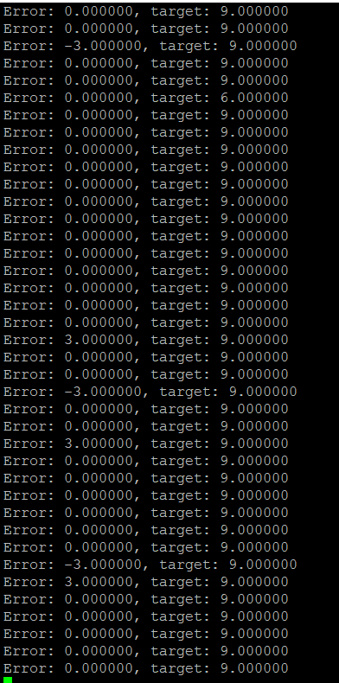
PID - Tuning Method:
Ziegler Nichols
Step 3: Find D value by determining the amount of errorless cycles
Notes:
Step 3: Find D value by determining the amount of errorless cycles. That’s how we fine tune the pid value

Slide 24
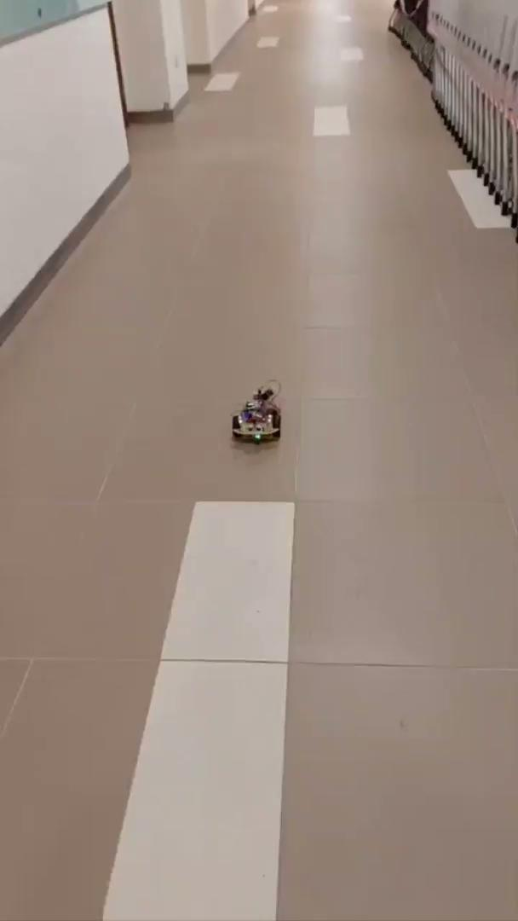
PID
Short
Long
Show how the PID vary for long vs short distance
Straight
Drift Left
Notes:
This is how the PID vary for short vs long distance. For the long distance the car drift towards the left side

Slide 25
Testing
Notes:
Next we will talk about the testing

Slide 26
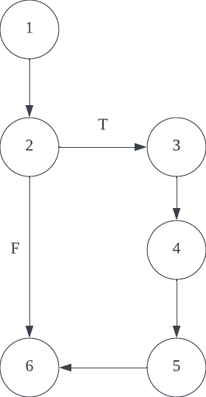
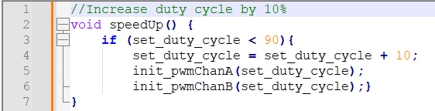
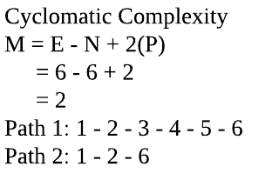
Testing: SpeedUp() Function
Test Cases
Test Case | set_duty_cycle | Outcome
1 | 80 | Set_duty_cycle = 90 (increased by 10)
2 | 90 | Set_duty_cycle = 90 (no change)
Notes:
This is the white box testing we did for our SpeedUp function which includes the control flow graph and test cases

Slide 27
Movement Compilation
Notes:
Next we will play a video to showcase all our movement function

Slide 28


Slide 29
The End

